Slide 1
Submitting your SOM Group Presentation

Slide 2
Two Submissions Required:
Group Leader ONLY will:
Upload Powerpoint slides to TURNITIN UK
Upload Video to CANVAS

Slide 3
1. Upload Powerpoint slides to Turnitin UK
Upload the completed Powerpoint slides Before you record narration/video
You can upload to Turnitin as a Powerpoint file
OR
Covert Your Powerpoint to PDF

Slide 4
Upload to Powerpoint Slides to Turnitin
Login to TurnitinUK
Click on SOM class
Click on the Click submit button for the 010 Group Presentation
See video guide on Submission to Turnitin UK

Slide 5
2. Upload Video of Powerpoint with narration to CANVAS
Record Narration of Slides
Save the Narrated Presentation as Video
Upload Video to Canvas

Slide 6
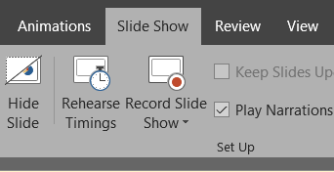
1. To Record Narration of Slides:
Select Record and start speaking.
Select Slide Show > Record Slide Show.
Choose from two options:
Record from Beginning - to record from the beginning of a presentation
Turn on/off Video based on your preference

Slide 7
NOTE:
Split up the slides, so each member has their set
Each member can record the narration of their slides on their computer
Then Group Leader will merge all narrated slides into ONE

Slide 8
2. Save the Narrated Presentation as Video
Select File > Export > Create a video
Ensure you Select Use Recorded Timings and Narrations
Select Create Video
Enter a file name: [SID_SOM_VideoPresentation]
Then browse to the location you want to save your video
Click Save

Slide 9
Alternative for creating Video
Use ZOOM free version
Group leader setup meeting
All login
First presenter will share their screen and present
Introduce next presenter
Second presenter will then share their screen and present
And so on.
DON’T Forget to click Record before you start.

Slide 10
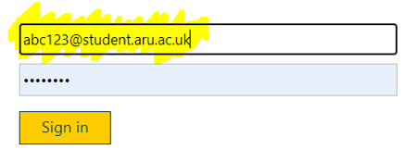
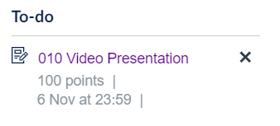
3. Upload Video to CANVAS
Go to https://canvas.anglia.ac.uk/
Login using your ARU email address and password
Choose Systems and Operations Management from Dashboard
Click on 010 Group Presentation on the TO DO LIST or from Assignments
Click the Submit Assignment button
Click Choose File
Then select the file you want to upload [SID_SOM_VideoPresentation]
Click Submit Assignment

Slide 11
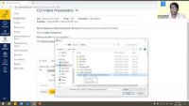
Submitting Video on Canvas https://youtu.be/Dk_6yzIp8TU

Slide 12
Guides from Microsoft
Save Powerpoint presentation as PDF files
Record Powerpoint Narration
Save a Powerpoint presentation as a video

